Slide 1


Weather App-pwa React Project Presentation
NISHA RAI
REG. NO: 12008898
Course code: INT252

Slide 2
Introduction
The Weather Prediction App is a user-friendly, responsive web application designed to provide real-time weather information for cities around the world. Built using the latest web technologies such as React, Axios, and the OpenWeatherMap API, this application aims to deliver accurate and up-to-date weather data in a visually appealing and easy-to-use interface.
With this project, users can quickly access current weather conditions, including temperature, humidity, wind speed, and atmospheric pressure, simply by entering the name of their desired city. The Weather Prediction App is not only a useful tool for travelers and weather enthusiasts, but also a showcase of modern web development practices and progressive web app features.
In this presentation, I will explore the main features and functionalities of the Weather Prediction App, the technologies used in its development.

Slide 3
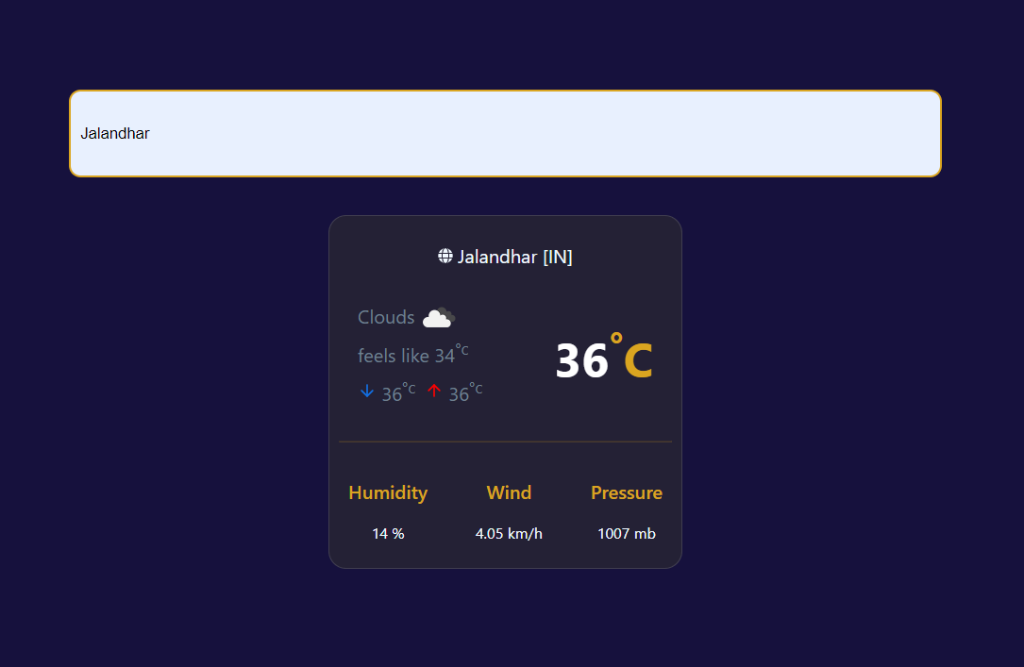

Weather App

Slide 4
Features
Search for weather by city name
Display current weather conditions, including:
Temperature (with feels-like, minimum, and maximum values)
Weather description and icon
Humidity
Wind speed
Atmospheric pressure
Responsive design for various devices

Slide 5
Technologies Used
React
(v18.2.0) for building user interface components
Axios
(v1.3.4) for making API requests
OpenWeatherMap API
for fetching weather data
React Icons
(v4.7.1) for using scalable vector icons

Slide 6
Implementation
App component as the main functional component
useState() for managing state variables (query and weather)
fetchWeather() function for making API requests
Responsive CSS styling for better user experience on different devices
Proper use of React components and hooks for better code organization

Slide 7

Conclusion
The Weather Prediction PWA is a user-friendly web application that allows users to search city and display current weather conditions for any city. The application leverages modern web technologies, including React, service workers, and the OpenWeatherMap API, to provide an engaging user experience with a clean and intuitive user interface. The Weather Prediction App showcases how modern web technologies can be used to create engaging and useful applications.

Slide 8

ThankYou….!

